Slide 1
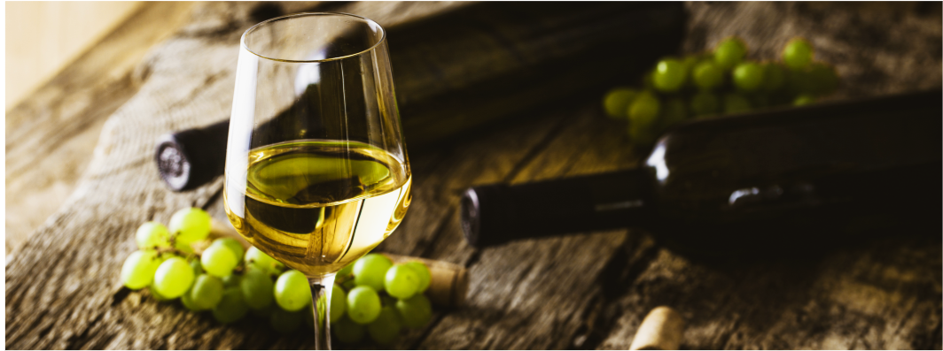
Wine Quality Analysis
By: H.Syed, M. Valenzuela, B. Sosa, G. McDaniel

Slide 2
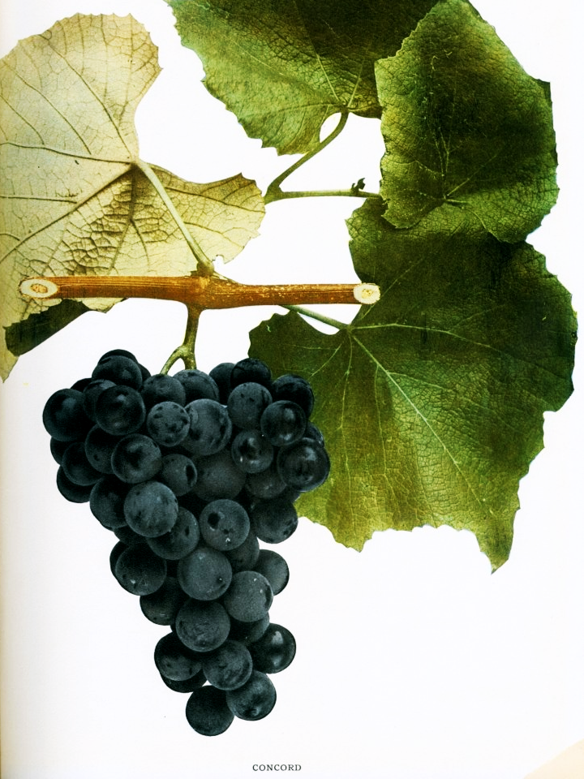
Wine Quality of Vinho Verde in Portugal
Why we picked this topic:
As a team, we were all interested in learning more about the attributes that determine the quality of wine. Different characteristics of wines can be influenced by the environment, region and soils wine grapes are grown in. We would like to isolate which variables are associated to high and low quality wines. A machine learning model will be composed to ingest the 11 characteristics to provide a quality score.
Description of the data source:
The two datasets are related to red and white variants of the Portuguese "Vinho Verde" wine. It displays 11 different characteristics of the grape variety.
Source Data: https://archive.ics.uci.edu/ml/datasets/Wine+Quality

Slide 3
Questions We Hope to Answer
What are the top five high quality wines?
What are the bottom five lowest quality wines?
How many wines have residual sugars above 10? (Off-Dry)
How many wines have residual sugars less than 0? (Bone-Dry)
How many wines have residual sugars higher than 20? (Medium-Sweet)
How many wines have an alcohol level greater than 15%?
How many wines have an alcohol level less than 11%?
How does each individual chemical property impact the overall quality score of wine?

Slide 4
Machine
Learning
Model
Using a supervised learning model, the independent variable (x) would be:
Fixed acidity
Volatile acidity
Citric acid
Residual sugar
Chlorides
Free sulfur dioxide
Total sulfur dioxide
Density
pH
Sulphates
Alcohol
The dependent variable (y) is 12 - quality (score between 0 and 10). Using sklearn we will split the testing and training data. We will use the training data to train the model and then use the testing data to see the results using the predict method. Then we will compare the testing and training outcomes to see if the model can accurately predict the wine quality score.

Slide 5
Technologies Used
Data Cleaning and Analysis:
Pandas will be used to clean the data and perform analysis.
Database Storage:
Postgres SQL is the database we selected to use to store the cleaned data
Machine Learning:
SciKit learn is the Machine Learning library for Python that we will use to make predictions on for our wine analysis for our project.
Dashboard:
We have selected Tableau to build the dashboard to present our results.

Slide 6
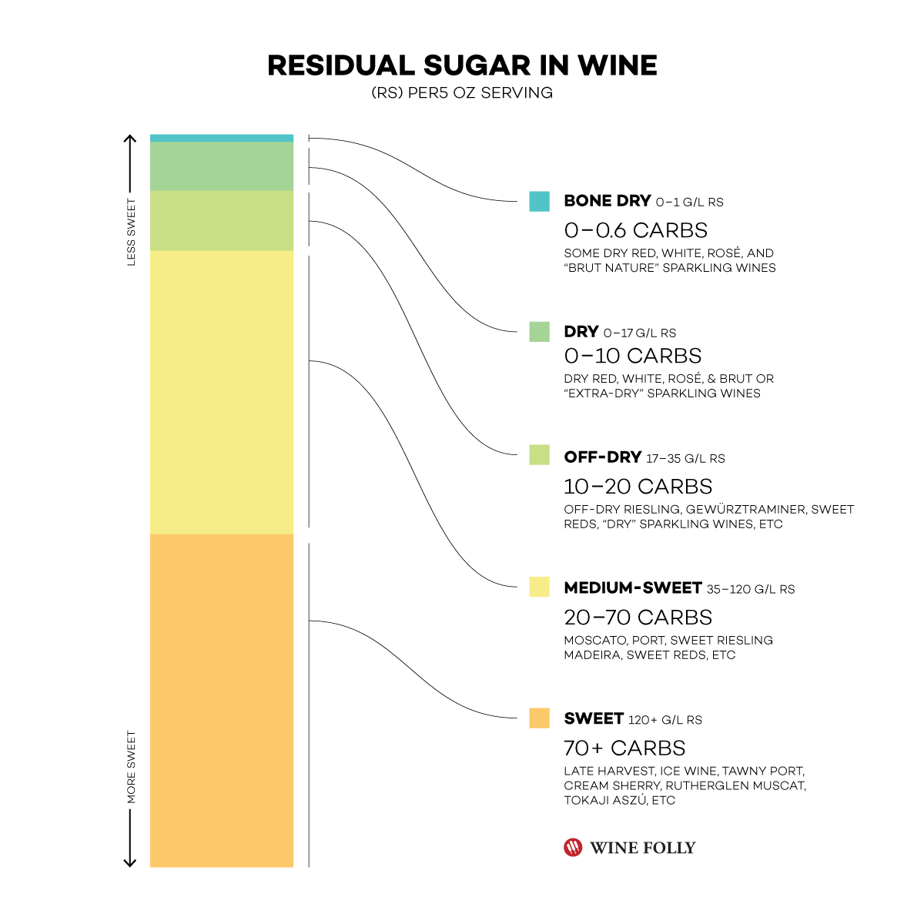
Impacting Variables
Alcohol
Typical % of alcohol is 12-15%, above 15% is considered a fortified wine
Residual Sugars
Contribute to the dryness or sweetness of the wine
Acidity - wines that lack fixed acidity are ‘1-dimensional / flat’*
Fixed (citric acid) - lower amounts may indicate spoilage
Sulfur Dioxide
It prevents the wine from reacting with oxygen which can cause browning and off-odors (oxidation), and it inhibits the growth of bacteria and undesirable wild yeasts in the grape juice and wine
Notes:
https://towardsdatascience.com/what-makes-a-wine-good-ea370601a8e4

Slide 7
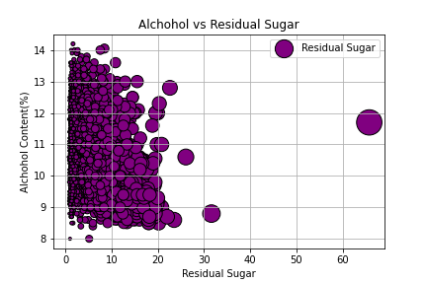

Slide 8
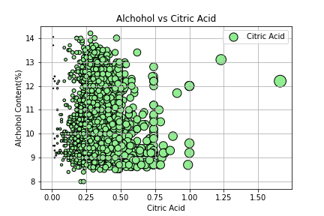

Slide 9
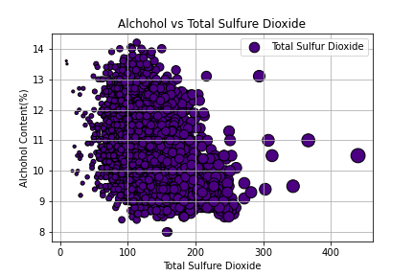

Slide 10
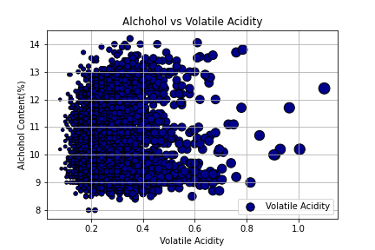

Slide 11
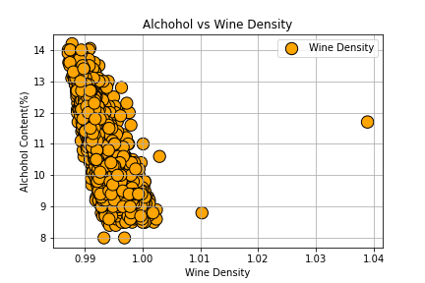

Slide 12
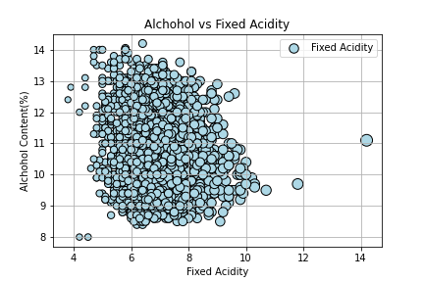

Slide 13
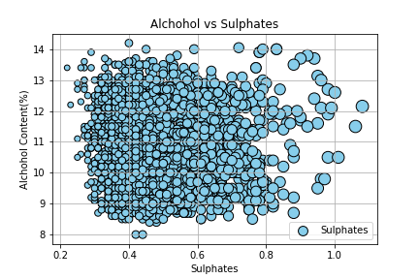

Slide 14
Dashboard Details
Tools:
Tableau - we will be using tableau for our data analysis visualization dashboard.
CSV Raw Data Files - our data will be imported via csv files to utilize in our development of various interactive graphs and charts.
Machine Learning Output - the machine learning output will be saved as a csv file and imported into Tableau.
Notes:
https://towardsdatascience.com/what-makes-a-wine-good-ea370601a8e4

Slide 15
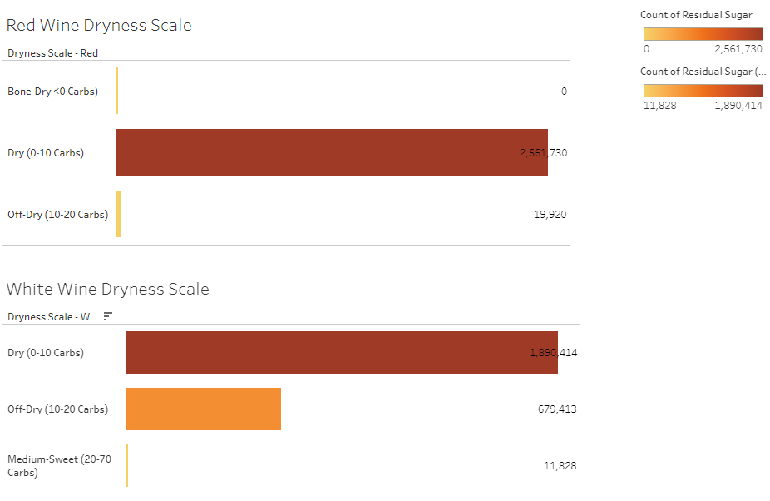
Dashboard Details
Interactive Element:
Scale Diagram - this will be a diagram comparing how residual sugar levels provide to the sweetness vs dryness of a wine.
Link to Dashboard: https://public.tableau.com/app/profile/mara.valenzuela8787/viz/WineQualityAnalysisDashboard/Dashboard1?publish=yes
Notes:
https://towardsdatascience.com/what-makes-a-wine-good-ea370601a8e4

Slide 16
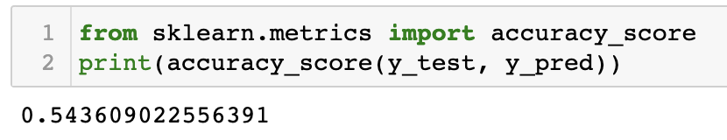
Results of the Analysis
Overview: We performed a machine learning model using logistic regression to predict the quality scores of red and white wine based on 11 characterstics, such as fixed acidity, citric acid, alcohol, sulfure dioxide.
Analysis: The result of our analysis based off the logistic regression model provided us with outcomes of quality scores. Our model prediction accuracy came out to be 0.54, which was a bit lower than what we expected. However, based on this accuracy score we can assume that the features within the dataset do not contribute greatly to the quality of wine.
Recommendation for Future Analysis: Using SciKit Learns RandomForestRegressor as another model to potentially get a better accuracy score.
Notes:
https://towardsdatascience.com/what-makes-a-wine-good-ea370601a8e4

